Slide 1
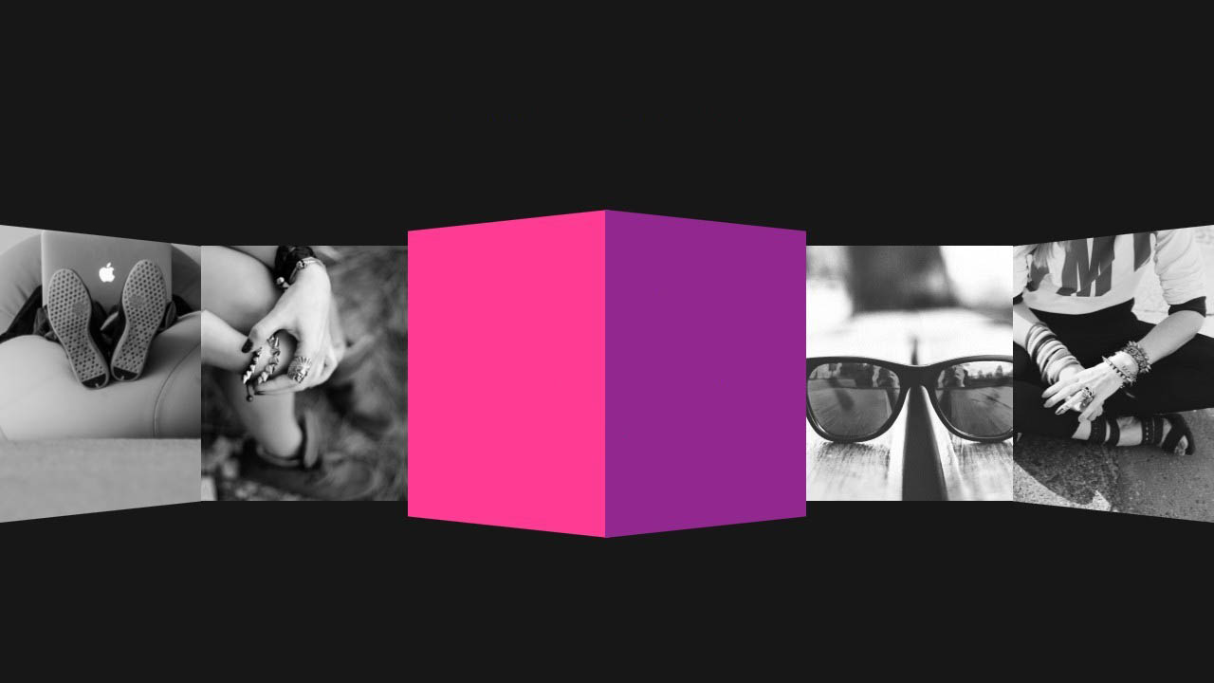
FASHION Trend Analysis

Slide 2

Data Mining and Predictive Analysis Project
Submitted to : Christina Schweikert
Submitted by : Preeti Usha Gupta
Project Aim
Fashion forecasting
Attributes used for analysis
WEKA Conclusion
Declining trends
Naïve Bayes Classifier
In’s and out’s of trending waistline
Trending Fabric
Conclusion

Slide 3
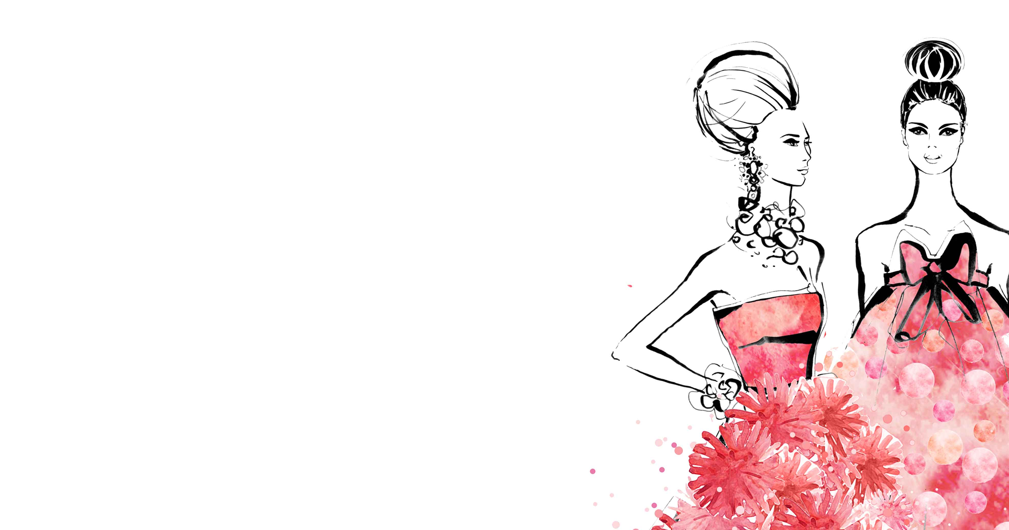
Aim of Project
To provide an understanding
of what trend forecasting.
Undertake research & analysis by
identifying and tracking fashion trends

Slide 4
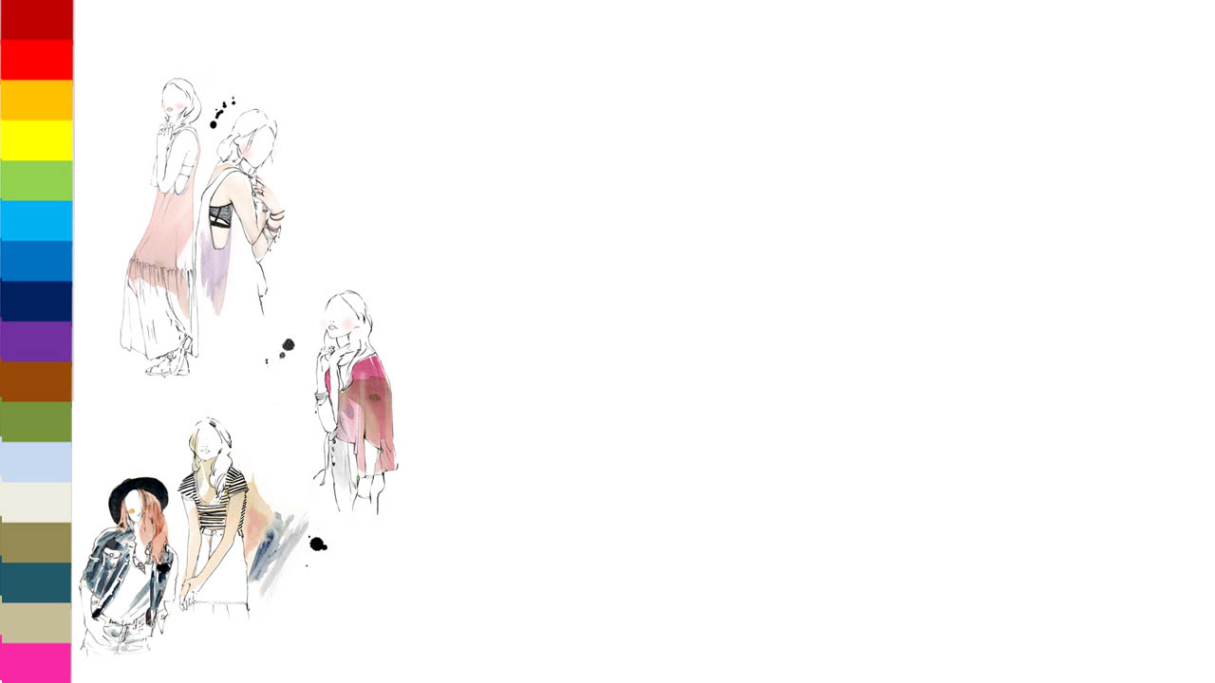
Fashion Forecasting
“Trends are profits waiting to happen”
For mainstream brands, timing is essential
Right product, Right place, at Right time
The knowledge of fashion forecasting is applied to understand how trends evolve and are interpreted by industry

Slide 5
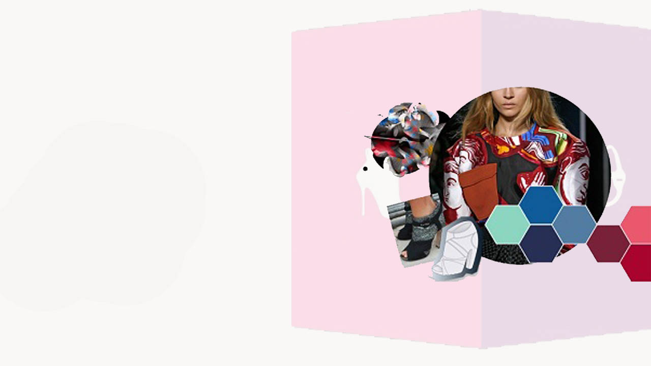
Attributes used for
TREND Analysis
Dress Id
Style
Size
Season
Neckline
Waistline
Material

Slide 6
Weka Conclusions
Conclusions drawn from J48 Classifier Result
Trending Styles
It is clear from the Run information of J48 classifier that casual dresses are most dominant. The trends analyzed are as follows

Slide 7
Declining Trends
It is clear from the Run information of J48 classifier that OL, Flare, Novelty outfits trend has declined over the period of time

Slide 8
Attribute Analysis using Naïve Bayes Classifier
Trending Neckline, Waistline and Fabric
The Naïve Bayes classifier is executed to analysis different dress attributes like Neckline, Waistline and Fabric .The trends analyzed are as follows
O-neck : 251 V- neck : 126

Slide 9
In’s and Out’s of Trending waistline

Slide 10
Trending Fabric Cotton is trending

Slide 11
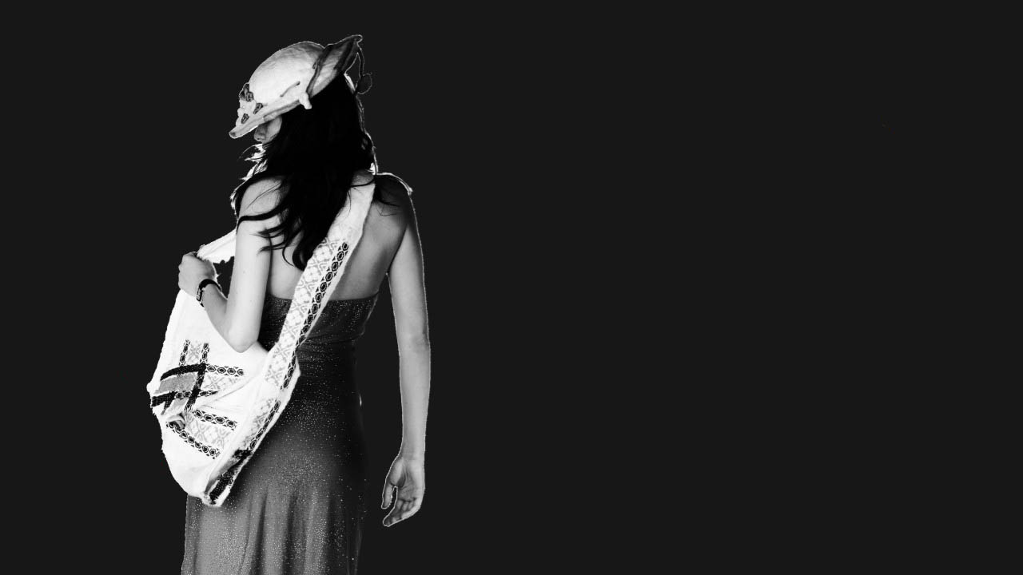
Conclusion
The dresses sold most during the all seasons were:
Cotton and polyester Casual, Sexy, Cute, Party.
Generally, dresses with empire or natural waistline having either v or o neckline were dominant .
Declining Trends
Novelty, OL, Flare Dresses were least sold.
Dresses with Drop Down Waistline and Princess Style were not so famous either
Biggest Seller of all seasons
Casual Dress
Thank
YOU

